Slide 1
Quantum communication: BB84 & EPR protocol
17/7/2021

Slide 2
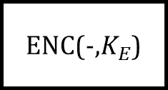

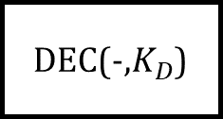
1. Intro
Symmetry
T
ENC
E
DEC
T
Old crypto
Alice
Bob
Asymmetry
T
ENC(-,$K_{E}$)
E
DEC(-,$K_{D}$)
T
Modern crypto: RSA
Alice
Bob
$K_{E}$ public

Slide 3
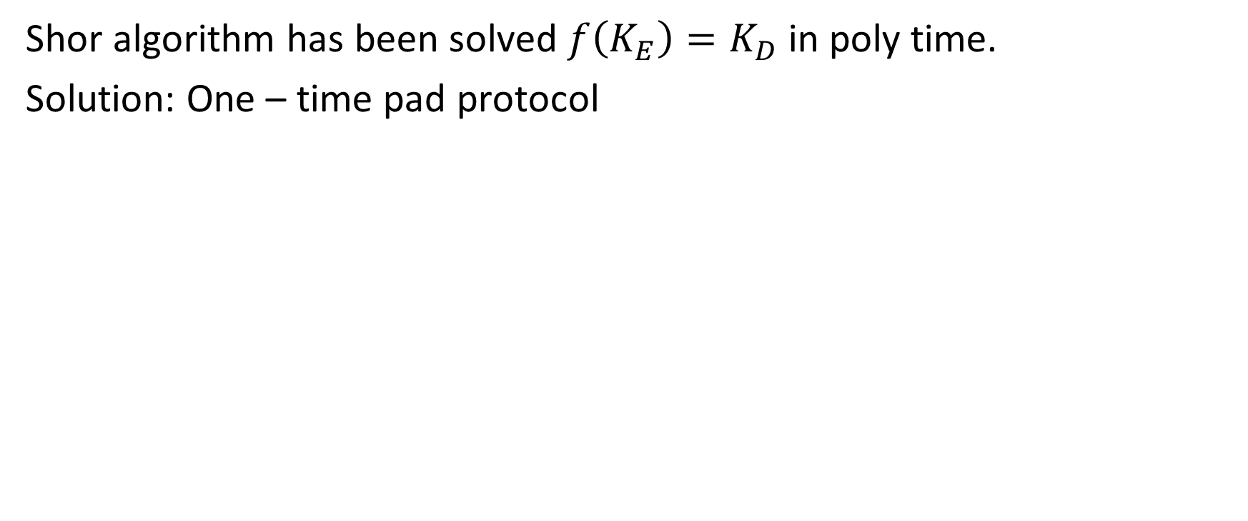
2. Problems
Shor algorithm has been solved $f\left(K_{E}\right)=K_{D}$ in poly time.
Solution: One – time pad protocol

Slide 4
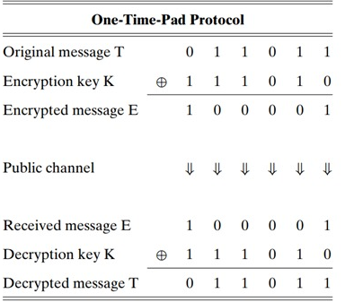
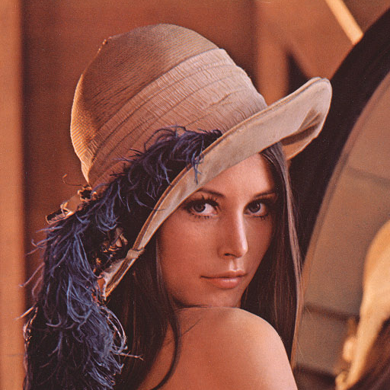




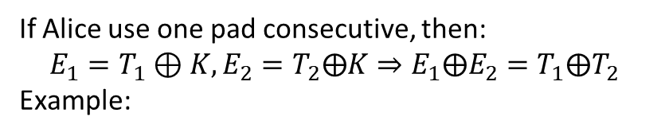



3. OTP protocol and its cons
If Alice use one pad consecutive, then:
$$E_{1}=T_{1}⊕K,E_{2}=T_{2}⨁K⇒E_{1}⨁E_{2}=T_{1}⨁T_{2}$$
Example:
$$K$$
$$T$$
$$E$$

Slide 5
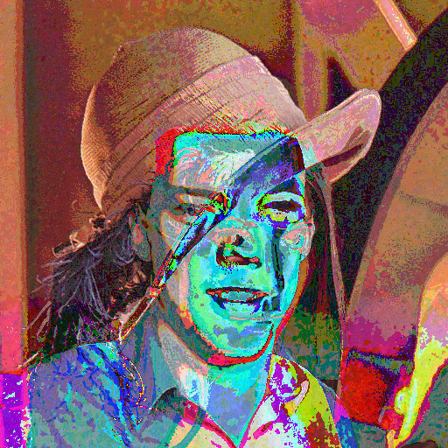






3. OTP protocol and its cons
$$⊕$$
$$⊕$$
$$⇒$$
$$K$$
$$T$$
$$E$$

Slide 6
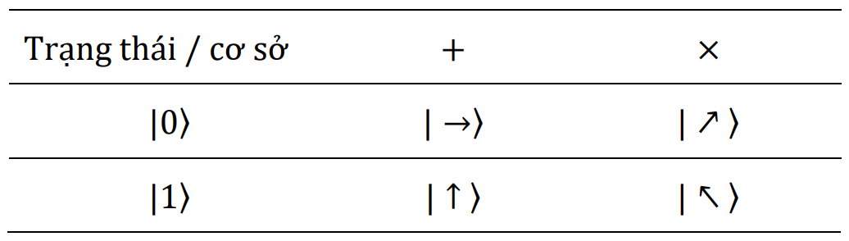
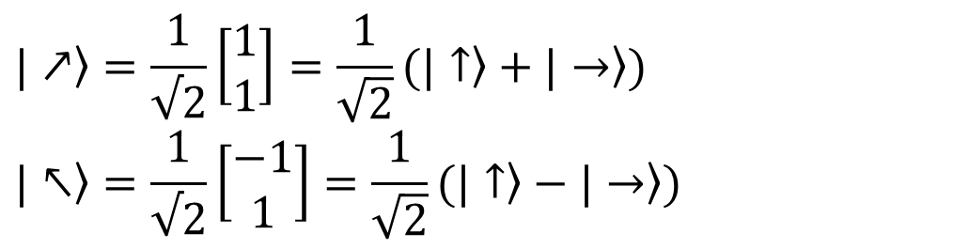
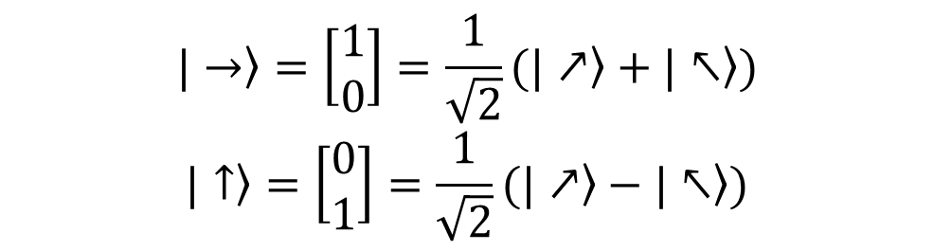
4. BB84 (Charles H. Bennett & Gilles Brassard)
$$\left.|→\right\rangle =\left[\begin{matrix}1 \\ 0\end{matrix}\right]=\frac{1}{\sqrt{2}}(\left.|↗\right\rangle +\left.|↖\right\rangle )$$
$$\left.|↑\right\rangle =\left[\begin{matrix}0 \\ 1\end{matrix}\right]=\frac{1}{\sqrt{2}}(\left.|↗\right\rangle −\left.|↖\right\rangle )$$
$$\left.|↗\right\rangle =\frac{1}{√2}\left[\begin{matrix}1 \\ 1\end{matrix}\right]=\frac{1}{\sqrt{2}}(\left.|↑\right\rangle +\left.|→\right\rangle )$$
$$\left.|↖\right\rangle =\frac{1}{√2}\left[\begin{matrix}−1 \\ 1\end{matrix}\right]=\frac{1}{\sqrt{2}}(\left.|↑\right\rangle −\left.|→\right\rangle )$$

Slide 7
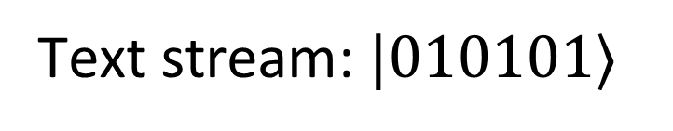
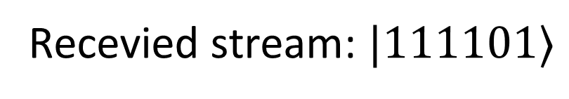
Encrypted stream
Text stream: $|010101⟩$
Recevied stream: $|111101⟩$

Slide 8
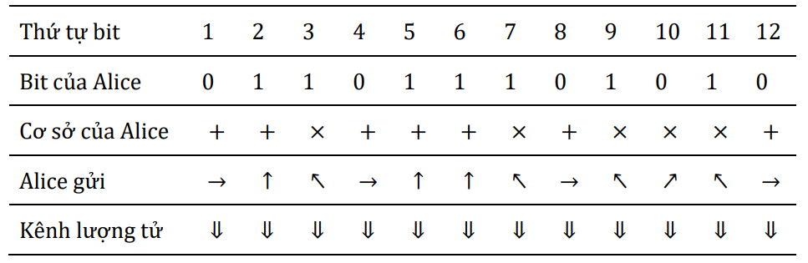
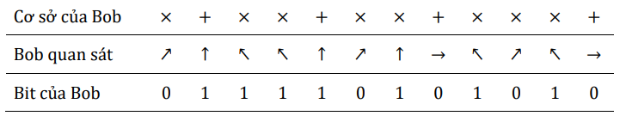
+

Slide 9
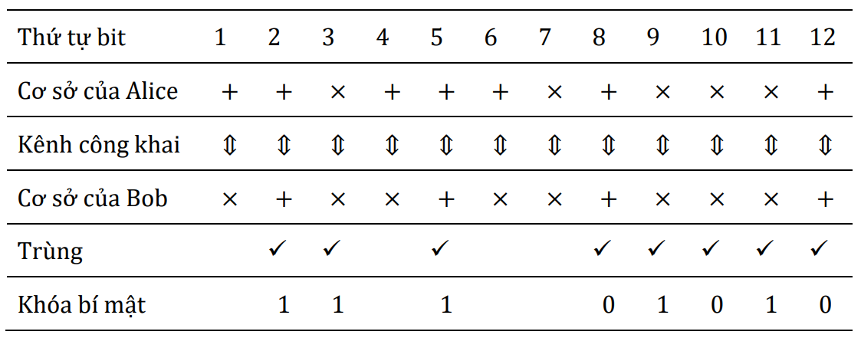
+

Slide 10
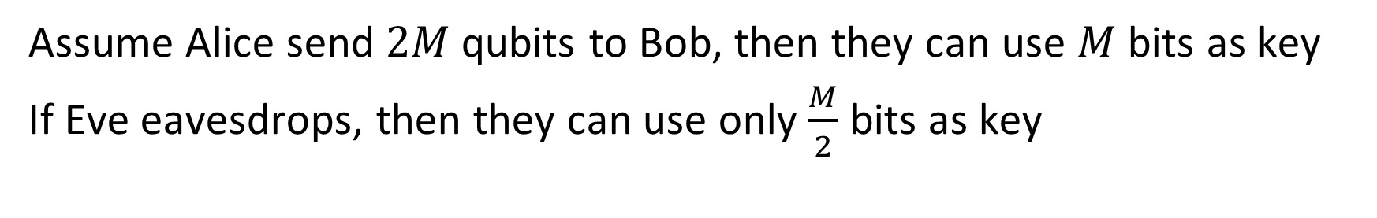
4. BB84 (Charles H. Bennett & Gilles Brassard)
Assume Alice send $2M$ qubits to Bob, then they can use $M$ bits as key
If Eve eavesdrops, then they can use only $\frac{M}{2}$ bits as key
x
Alice
Bob
Eve

Slide 11
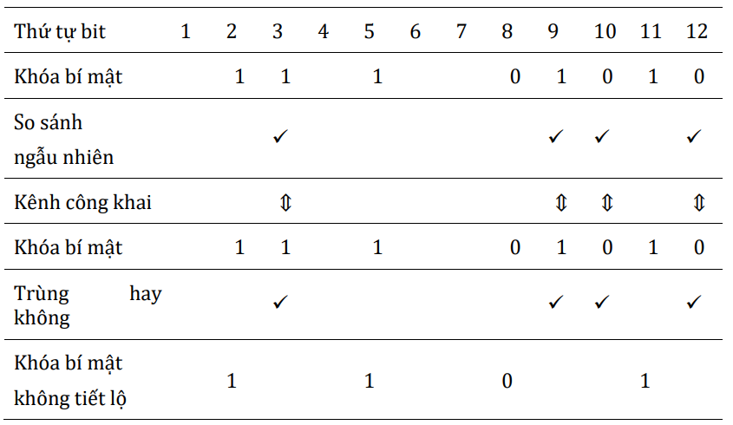

Slide 12
EPR protocol (E91)
Ekert, 1991
2/10/2021

Slide 13
Spin

Slide 14
Superposition

Slide 15
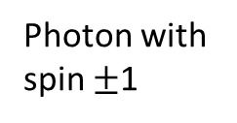
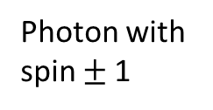
EPR Pradox (Einstein, Podolsky và Rosen, 1935)
1120 km, 2020
Photon with spin $±$1
Photon with spin $±$1
Crystal
High energy photon

Slide 16
EPR Pradox: when measure
“Spooky action”
Photon with spin 1
Crystal
High energy photon

Slide 17
EPR Pradox: when measure
“Spooky action”
Photon with spin -1
Photon with spin 1
Crystal
High energy photon

Slide 18
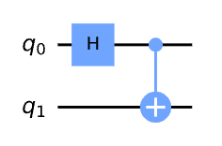
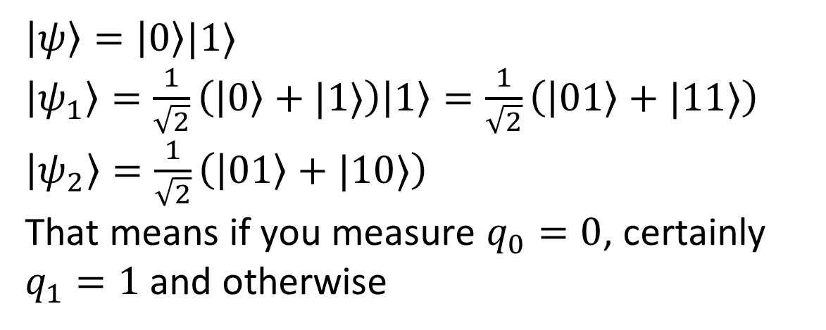
Entangled state
X
$\left|ψ\right\rangle =\left|0\right\rangle |1⟩$
$\left|ψ_{1}\right\rangle =\frac{1}{\sqrt{2}}\left(\left|0\right\rangle +|1⟩\right)\left|1\right\rangle =\frac{1}{\sqrt{2}}\left(\left|01\right\rangle +|11⟩\right)$
$\left|ψ_{2}\right\rangle =\frac{1}{\sqrt{2}}\left(\left|01\right\rangle +|10⟩\right)$
That means if you measure $q_{0}=0$, certainly $q_{1}=1$ and otherwise

Slide 19
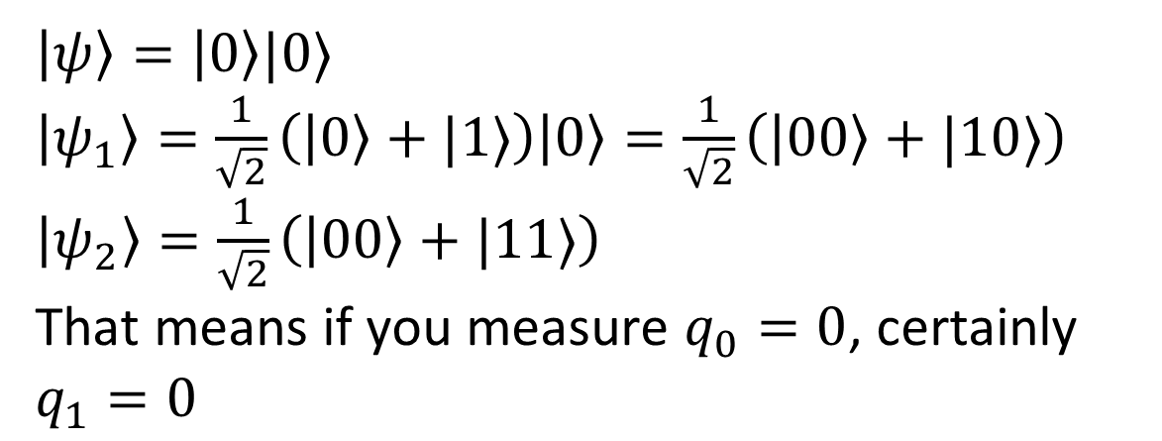
Entangled state
$\left|ψ\right\rangle =\left|0\right\rangle |0⟩$
$\left|ψ_{1}\right\rangle =\frac{1}{\sqrt{2}}\left(\left|0\right\rangle +|1⟩\right)\left|0\right\rangle =\frac{1}{\sqrt{2}}\left(\left|00\right\rangle +|10⟩\right)$
$\left|ψ_{2}\right\rangle =\frac{1}{\sqrt{2}}\left(\left|00\right\rangle +|11⟩\right)$
That means if you measure $q_{0}=0$, certainly $q_{1}=0$

Slide 20
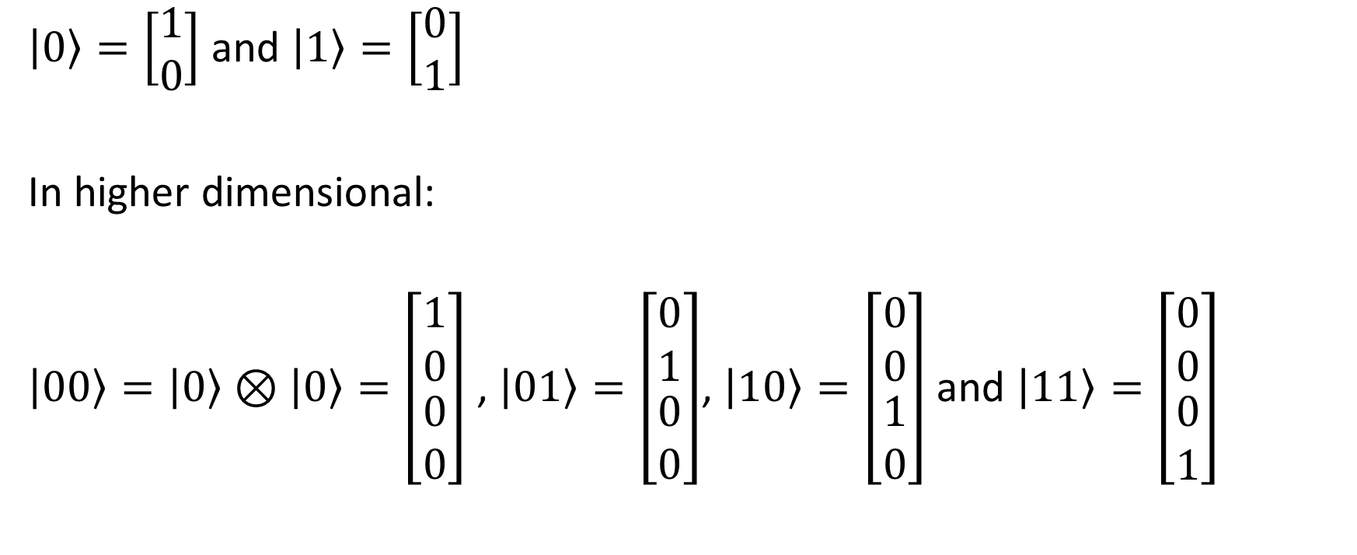
Classical basis
$\left|0\right\rangle =\left[\begin{matrix}1 \\ 0\end{matrix}\right]$ and $\left|1\right\rangle =\left[\begin{matrix}0 \\ 1\end{matrix}\right]$
In higher dimensional:
$\left|00\right\rangle =\left|0\right\rangle ⊗\left|0\right\rangle =\left[\begin{matrix}1 \\ 0 \\ \begin{matrix}0 \\ 0\end{matrix}\end{matrix}\right]$ , $\left|01\right\rangle =\left[\begin{matrix}0 \\ 1 \\ \begin{matrix}0 \\ 0\end{matrix}\end{matrix}\right]$, $\left|10\right\rangle =\left[\begin{matrix}0 \\ 0 \\ \begin{matrix}1 \\ 0\end{matrix}\end{matrix}\right]$ and $\left|11\right\rangle =\left[\begin{matrix}0 \\ 0 \\ \begin{matrix}0 \\ 1\end{matrix}\end{matrix}\right]$

Slide 21
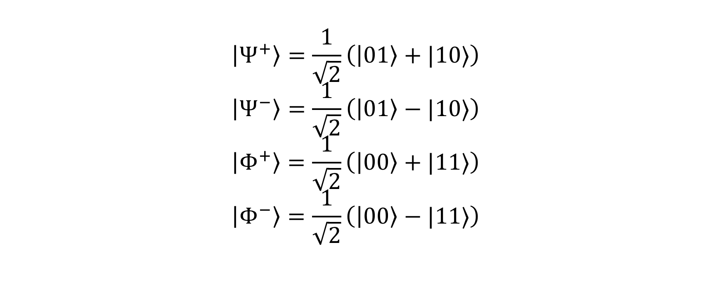
Bell basis
$$\left|Ψ^{+}\right\rangle =\frac{1}{\sqrt{2}}\left(\left|01\right\rangle +|10⟩\right)$$
$$\left|Ψ^{−}\right\rangle =\frac{1}{\sqrt{2}}\left(\left|01\right\rangle −|10⟩\right)$$
$$\left|Φ^{+}\right\rangle =\frac{1}{\sqrt{2}}\left(\left|00\right\rangle +|11⟩\right)$$
$$\left|Φ^{−}\right\rangle =\frac{1}{\sqrt{2}}\left(\left|00\right\rangle −|11⟩\right)$$

Slide 22
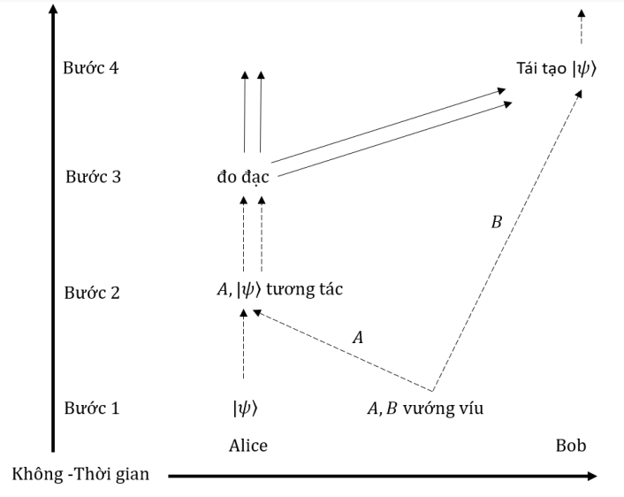
EPR protocol

Slide 23
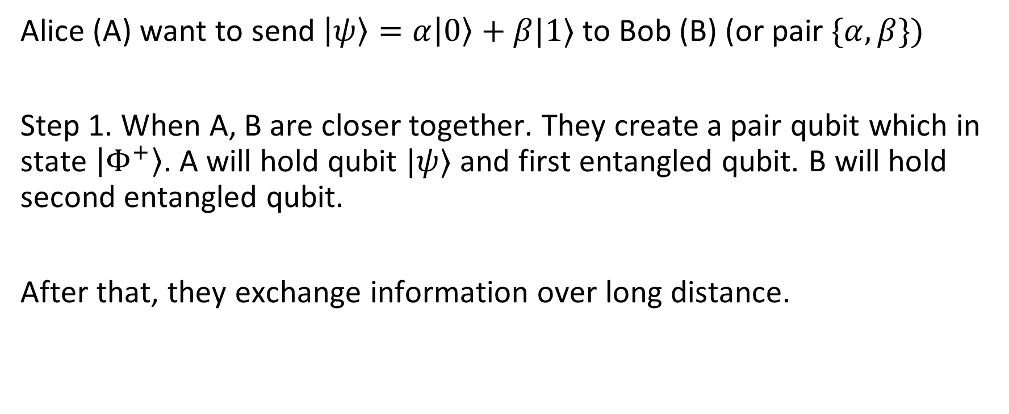

EPR protocol
Alice (A) want to send $\left|ψ\right\rangle =α\left|0\right\rangle +β|1⟩$ to Bob (B) (or pair $\{α,β\})$
Step 1. When A, B are closer together. They create a pair qubit which in state $\left|Φ^{+}\right\rangle$. A will hold qubit $|ψ⟩$ and first entangled qubit. B will hold second entangled qubit.
After that, they exchange information over long distance.

Slide 24
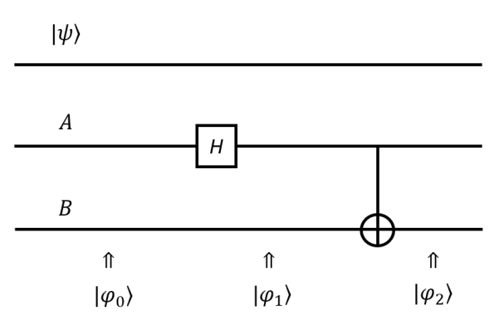
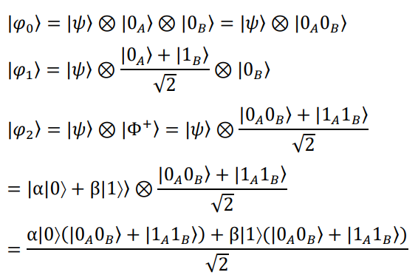
EPR protocol: Step 1

Slide 25
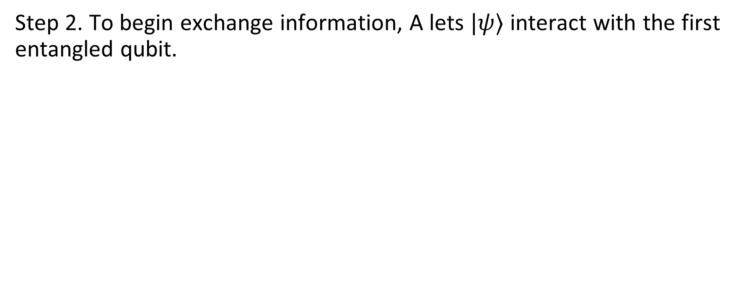
EPR protocol
Step 2. To begin exchange information, A lets $|ψ⟩$ interact with the first entangled qubit.

Slide 26
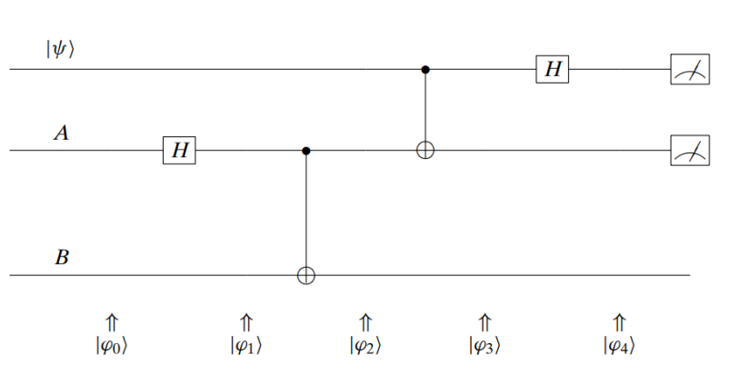
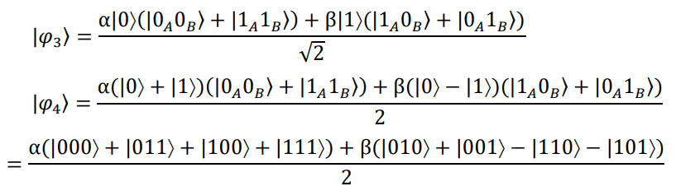
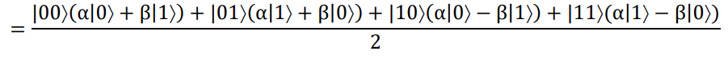
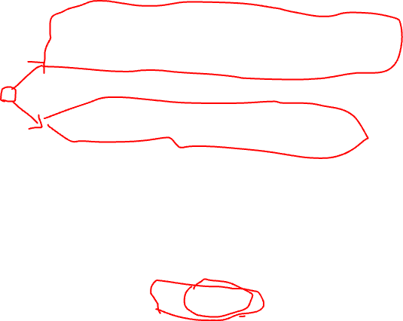
EPR protocol: Step 2
Superposition of 4 states.
Note that two first qubit is in Alice’s possession

Slide 27
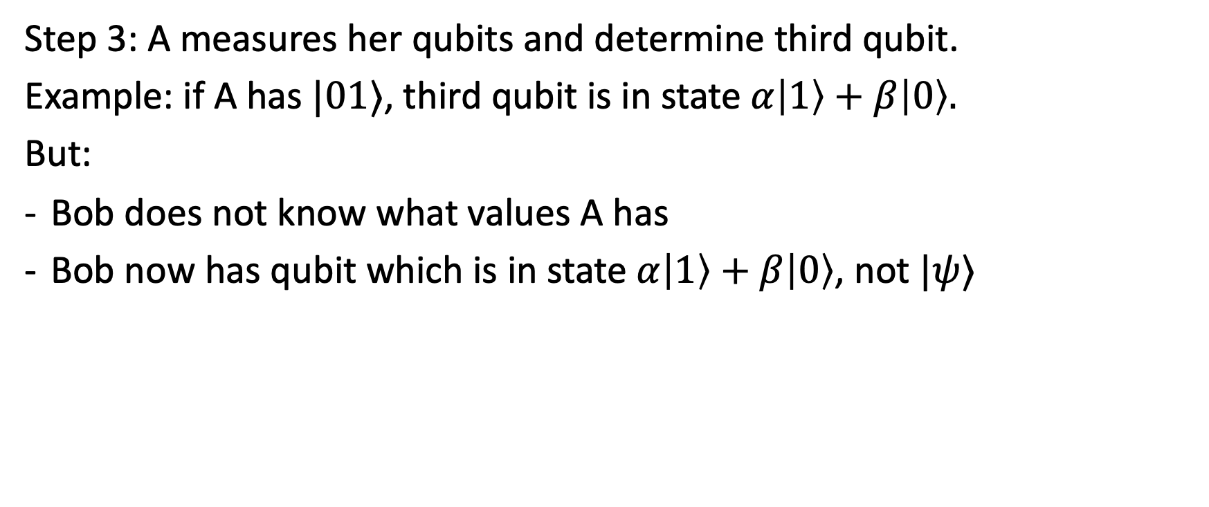
EPR protocol: Step 3
Step 3: A measures her qubits and determine third qubit.
Example: if A has $|01⟩$, third qubit is in state $α\left|1\right\rangle +β\left|0\right\rangle .$
But:
Bob does not know what values A has
Bob now has qubit which is in state $α\left|1\right\rangle +β\left|0\right\rangle$, not $|ψ⟩$

Slide 28
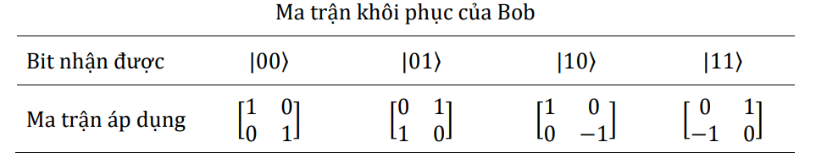
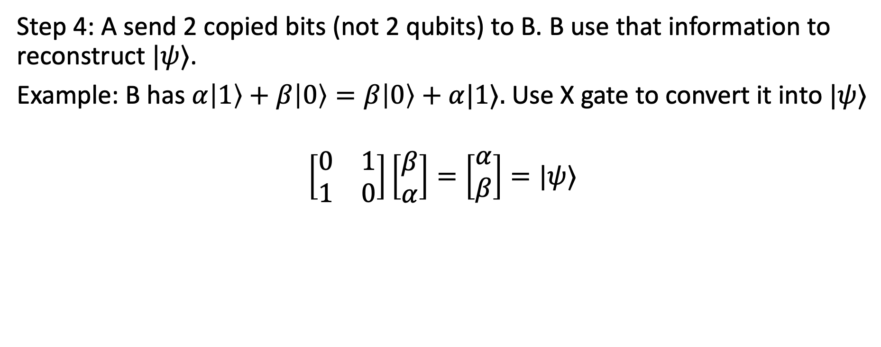
EPR protocol: Step 4
Step 4: A send 2 copied bits (not 2 qubits) to B. B use that information to reconstruct $|ψ⟩$.
Example: B has $α\left|1\right\rangle +β\left|0\right\rangle =β\left|0\right\rangle +α|1⟩.$ Use X gate to convert it into $|ψ⟩$
$$\left[\begin{matrix}0 & 1 \\ 1 & 0\end{matrix}\right]\left[\begin{matrix}β \\ α\end{matrix}\right]=\left[\begin{matrix}α \\ β\end{matrix}\right]=|ψ⟩$$

Slide 29
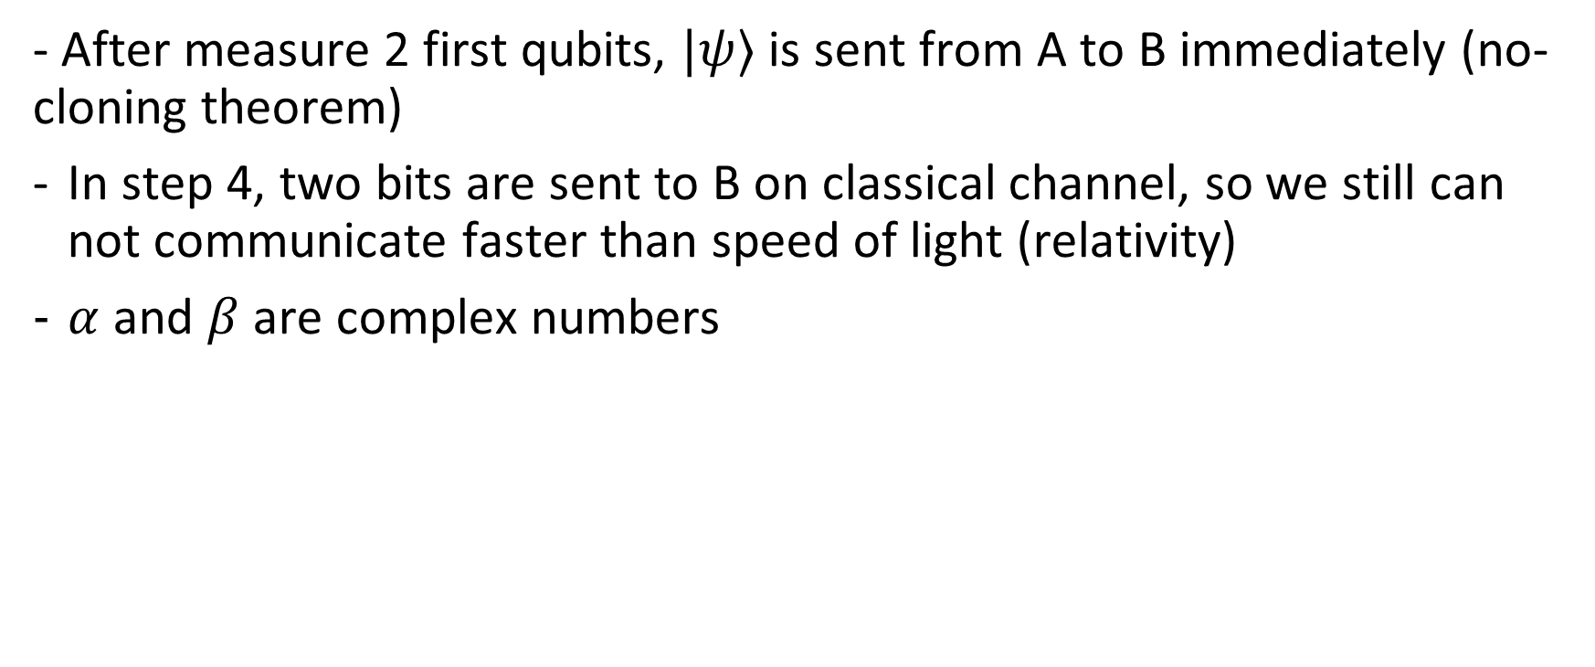
Summary
- After measure 2 first qubits, $|ψ⟩$ is sent from A to B immediately (no-cloning theorem)
In step 4, two bits are sent to B on classical channel, so we still can not communicate faster than speed of light (relativity)
$α$ and $β$ are complex numbers

